Slide 1

Mid Term Project
Clinic OPD Booking System
Submitted by: Neha C. Dangat
Submission type : Individual
Name: Neha c. Dangat.
Batch : HDFC Api Developer
Program : API Full stack developer
Date: 20 /04 /2023

Slide 2
Table of contents
Introduction
Project Overview
Architecture Design
User Interface Design
Back-end Development
Integration
Conclusion
Future Work
References
Appendices

Slide 3
Introduction
The Clinic OPD booking system is an essential requirement for our healthcare organization to efficiently manage patient appointments and improve the overall patient experience. The objective of this system is to streamline the patient booking process, reduce wait times, and enhance the quality of care provided to patients. This business requirement document outlines the functional and non-functional requirements of the Clinic OPD Booking System.

Slide 4
Project Overview
A clinic OPD (Out-Patient Department) booking system is a software application designed to streamline the process of scheduling appointments for patients who need to visit a clinic for medical consultation or treatment. The system can be used by both patients and clinic staff to manage appointment scheduling, patient information, and other related activities.
The main objective of the system is to provide an easy-to-use and efficient way for patients to book appointments with the clinic. The system should be accessible through the clinic's website or mobile application and allow patients to select a doctor, choose a date and time, and provide any necessary information or medical history. The system should also be capable of sending appointment reminders and notifications to patients to reduce no-shows and improve patient attendance.

Slide 5
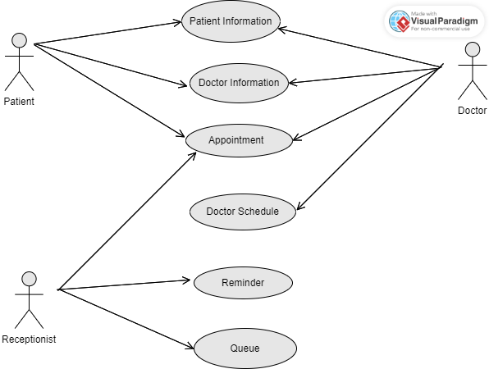






UML DIAGRAM

Slide 6
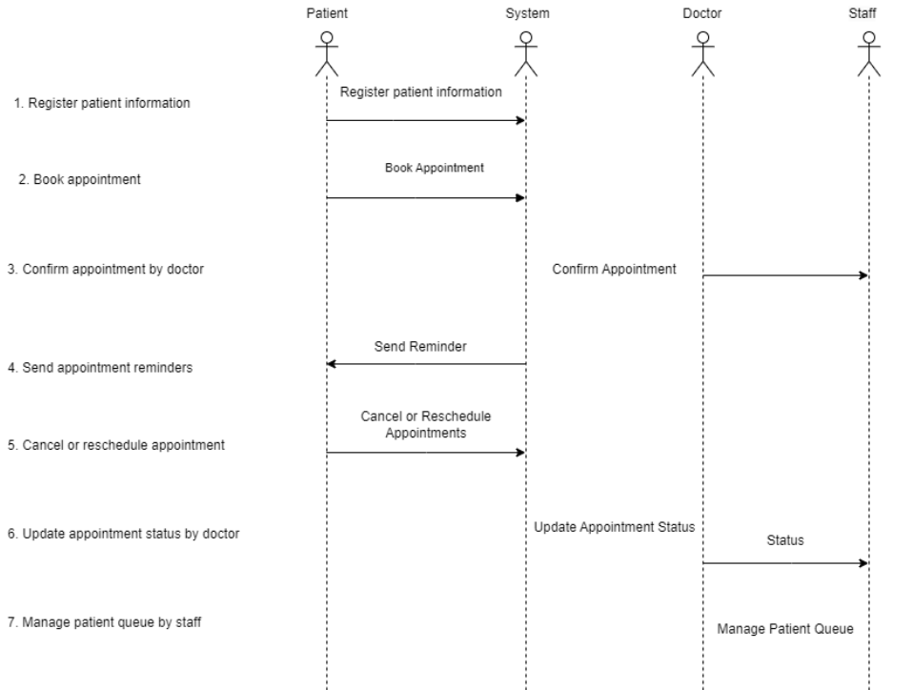
USER INTERFACE DESIGN

Slide 7
Back-end Development
We choose the Java Programming language and SQL database management system on based on the project requirements. Design the database schema and create the necessary tables, columns, and relationships to store patient and appointment data. Develop the RESTful API endpoints that will be used to communicate between the front-end and back-end of the system. These endpoints will handle requests from the front-end and provide responses with the requested data. Write the code that implements the core business logic of the system, including functions for appointment scheduling, patient information management, and appointment reminders. Implement data encryption and access control mechanisms to ensure the security and privacy of patient information. Integrate with third-party services, such as postman. Test the back-end code for bugs and errors, and ensure that it performs as expected.

Slide 8
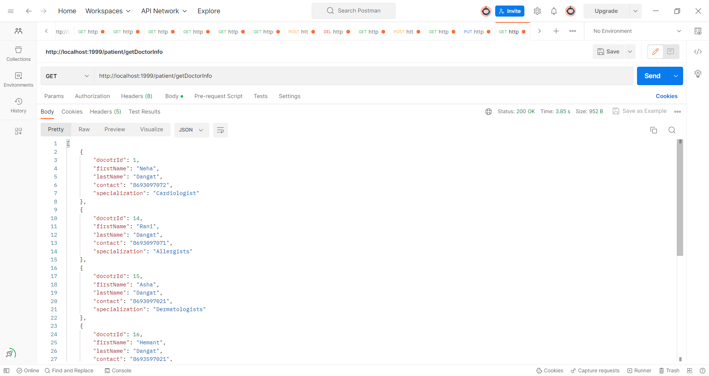
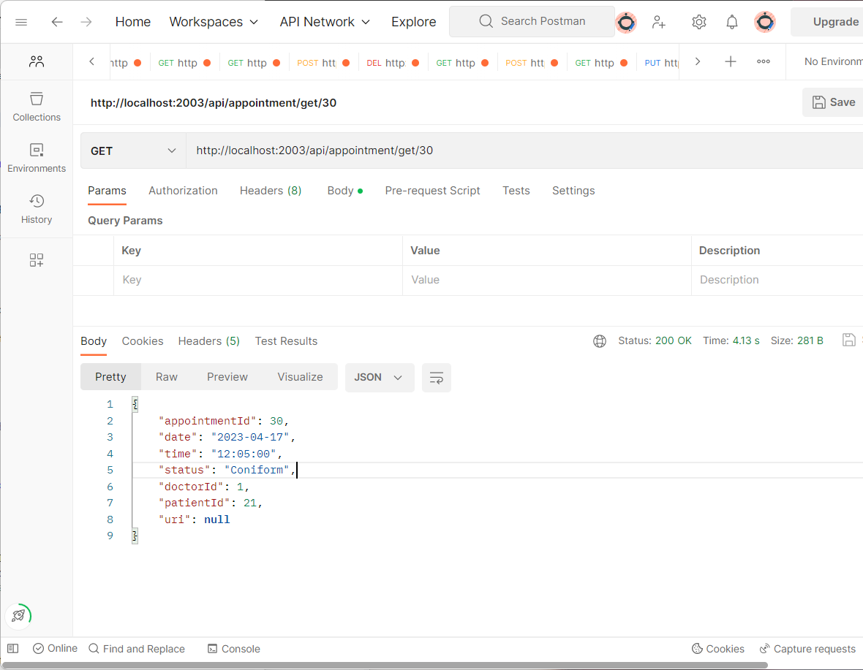
Integration

Slide 9
Conclusion
In conclusion, the clinic OPD booking system is an essential tool for healthcare providers to streamline their appointment scheduling and management processes. The system's functional requirements include patient registration, appointment booking, appointment management, doctor scheduling, reminders and notifications, cancellation and rescheduling, and patient queue management. By implementing this system, clinics can improve patient experience, reduce waiting times, and enhance the efficiency and accuracy of their operations. Moreover, the future scope of the clinic OPD booking system includes integration with telemedicine, mobile application development. By continuously improving and expanding the system's functionality, healthcare providers can provide better care and service to their patients.

Slide 10
Future Work
Developing a mobile application for the clinic OPD booking system can provide a more seamless and user-friendly experience for patients, allowing them to book appointments and receive notifications on-the-go.
The future scope of the clinic OPD booking system can include integration with telemedicine platforms, allowing doctors to conduct consultations remotely. This feature can enable patients to access medical services from the comfort of their homes, improving accessibility and convenience.

Slide 11
References
All Training notes and VC Lectures
www.google.com
www.youtube.com

